Slide 1
Computer Organization and Architecture
Dr. Hammad Afzal
1st Oct, 2010

Slide 2
Lecture 10
Remaining Part of
Addressing Modes
Chapter 11 of William Stallings's Book:
Computer Organization and Architecture

Slide 3
Addressing Modes
An architecture addressing modes are the set of syntaxes and methods that instructions use to specify a memory address
For operands or results
As a target address for a branch instruction
When a microprocessor accesses memory, to either read or write data, it must specify the memory address it needs to access
Several addressing modes to generate this address are known, a microprocessor instruction set architecture may contain some or all of those modes, deepening on its design

Slide 4
Addressing Modes
Immediate
Direct
Indirect
Register
Register Indirect
Displacement (Indexed)
Stack
Notes:
2

Slide 5
Displacement Addressing
EA = A + (R)
Address field hold two values
A = base value
R = register that holds displacement
or vice versa
Notes:
15

Slide 6
Displacement addressing mode
Instruction
Memory
Opcode
Register R
Address A
Pointer to
Operand
+
Operand
Registers
Effective Address = A + (content of R)
Address field hold two values
A = base value
R = register that holds displacement
or vice versa

Slide 7
Relative Addressing or PC-relative addressing
A version of displacement addressing
R = Program counter, PC
EA = A + (PC)
i.e. get operand from A cells from current location pointed to by PC
Notes:
17

Slide 8
Relative addressing mode
It is a particular case of the displacement addressing, where the register is the program counter; the supplied operand is an offset; Effective Address = A + (PC)
The offset is added to the content of the CPU’s program counter register to generate the required address
The program counter contains the address of next instruction to be executed, so the same relative instruction will produce different addresses at different locations in the program

Slide 9
Base-Register Addressing
A holds displacement
R holds pointer to base address (memory)
And address field contains displacement.
e.g. used for segmentation
Notes:
18

Slide 10
Indexed Addressing
A = base
R = displacement
EA = A + R
Opposite of base register addressing
Good for accessing arrays
EA = A + R
R++
Index Registers
Auto-indexing
Notes:
19

Slide 11
Combinations
Both indirect addressing and indexing are applied.
Post-index: indexing performed after indirection.
EA = (A) + (R)
Pre-index
EA = (A+(R))
(Draw the diagrams)
Notes:
20

Slide 12
Stack Addressing
Operand is (implicitly) on top of stack
e.g.
ADD Pop top two items from stack and add
Notes:
21

Slide 13
Instruction formats (1)
An instruction is represented as a binary value with specific format, called the instruction code
It is made out of different groups of bits, with different significations:
Opcode – represents the operation to be performed (it is the instruction identifier)
Operands – one, two or three represent the operands of the operation to be performed
A microprocessor can have one format for all the instructions or can have several different formats
An instruction is represented by a single instruction code

Slide 14
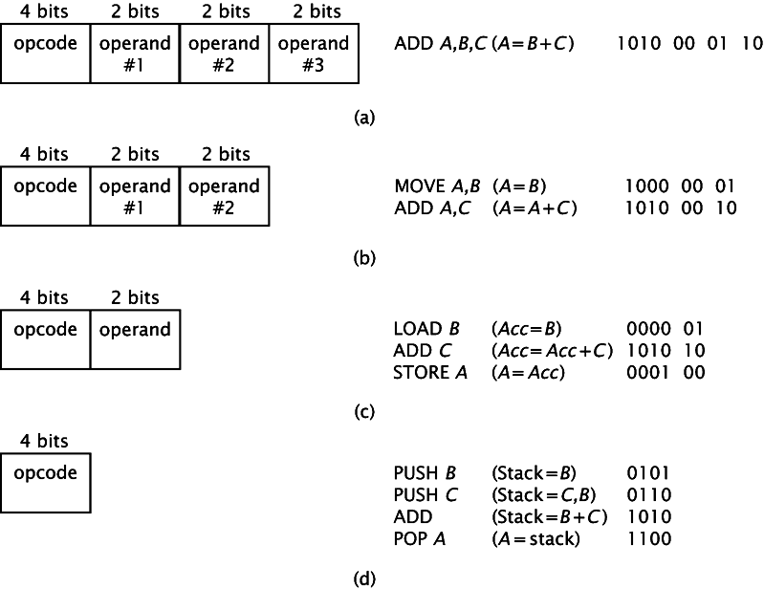
Instruction formats (2)
Notes:
Consider a simplified example A=B+C
This instruction is an addition, with two source operands (B and C) and a destination operand (A)
If we are using 4 bits to represent the opcode of the instruction, then we will have 16 possible operations, including the addition. Assume that the bit pattern 1010 represents the addition operation.
For this example, there are four possible operands (2 bits representation). For this example A is 00, B is 01, C is 10 and D is 11.
A microprocessor can be designed with instructions that can take 3, 2, 1 or no operand. The possible format instructions for those cases are presented.

Slide 15
Instruction Length
Affected by and affects:
Memory size: operand address
Memory organization
Bus structure
CPU complexity
CPU speed
Trade off between powerful instruction repertoire and saving space

Slide 16
Allocation of Bits
Number of addressing modes
Number of operands
Register versus memory
Number of register sets
Address range
Address granularity
An address can reference a word or byte.

